Slide 1
A DATA-DRIVEN EXPLORATION OF INDIAN MAKE CAR CRASH DATA THROUGH MODELING AND ENSEMBLE TECHNIQUES
GROUP-09_DSBD-01:
PULKIT BANSAL
VIVEK KUMAR
DEEPTI KOTI
UPPU UMA MAHESH
SUMIT BHANDARI
SUBASH S.
ASHISH KUMAR

Slide 2
CONTENTS
BACKGROUND & PROBLEM MOTIVATION
OBJECTIVES
DATA
DESCRIPTIVE & PREDITIVE ANALYSIS
RESULTS & INTERPRETATIONS
RECOMMENDATION & CONCLUSION
REFERENCES

Slide 3
1 BACKROUND
Factors contributing to the road accidents-
Speeding
Influence of alcohol and drugs
Non usage of motorcycle helmets, seat belts, child seats etc.
Distracted driving
Unsafe road structures
Unsafe vehicles
Inadequate enforcement of traffic laws
World Health Organization (WHO) reports: ~1.19 million people die each year as a result of road traffic crashes
Technology advancements - seat belts to airbags, anti-lock braking systems (ABS), electronic stability control (ESC), and advanced driver assistance systems (ADAS)

Slide 4
1 PROBLEM MOTIVATION
Technology advancements - seat belts to airbags, anti-lock braking systems (ABS),
electronic stability control (ESC), and advanced driver assistance systems (ADAS)
Ministry of Road Transport and Highways (MoRTH):
India has the highest number of road traffic fatalities, with approximately 1.5 lakh deaths annually
In 2022, road accidents accounted for more than 4.6 lakhs road accidents
1.6+ lakhs lives and causing injuries to 4.4+ lakhs individuals.
Motivation:
Reducing the staggering number of road traffic fatalities and injuries
Impose significant economic burdens on the society, including healthcare costs, loss of productivity, and damage to infrastructure

Slide 5
2 OBJECTIVES
Perform descriptive analysis
Provide visualizations and interpretations of performance metrics
Identify Factors Influencing Crash Severity
Evaluate the Effectiveness of Safety Features
Identify High-Risk Scenarios and Locations
Explore Temporal Patterns and Trends
Understand Demographic and Gender-Based Impacts
Assess Vehicle Safety Performance
Develop Predictive Models for Crash Severity
Support Decision-Making for Vehicle Design and Regulations
Support Consumer Choice

Slide 6
3 DATA
Vehicle_make.
Vehicle_type
Vehicle_Avg_Price (in Rs.)
Vehicle_year
Engine_type
Engine_displacement
Transmission_type:
Number_of_cylinders
Vehicle_weight(kg)
Vehicle_length(mm)
Vehicle_width(mm)
Vehicle_height(mm)
Safety_rating
Number_of_airbags
ABS_presence
ESC_presence
TCS_presence
TPMS_presence
Crash_location
Weather_conditions
Road_surface_conditions
Time_of_day
Day_of_week
Driver_age
Driver_gender
Crash_severity
Imbalanced- does not follow normal distribution
Severity is derived based on the condition of vehicle post-crash

Slide 7
4 DESCRIPTIVE & PREDICTIVE ANALYSIS
Tools:
R-Studio, PyCharm, Jupiter Notebook, MS Excel and Tableau Public
Data Standardization
Exploratory Data Analysis (EDA)
Standard Scaler
Logistic Regression Model
Other prediction models : Naïve Bayes, KNN, Decision Tree Classifier, Gradient Boosting Classifier, Random Forest Classifier using significant variables with and without Manufacturer variable. \
Dashboard - https://public.tableau.com/app/profile/deepti.k6218/viz/CapstoneProject-VehicleSafetyAnalysis/Dashboard1#1

Slide 8
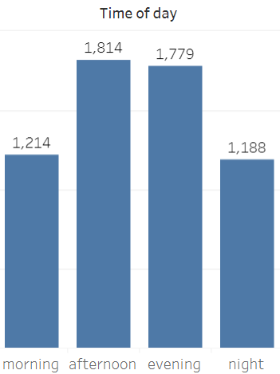
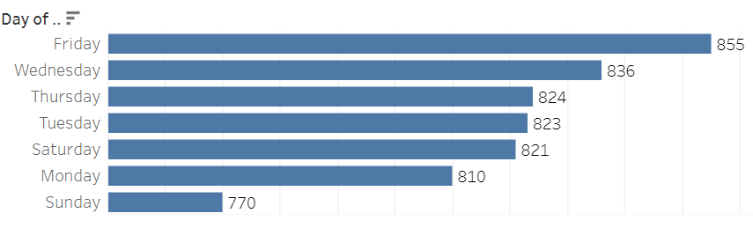
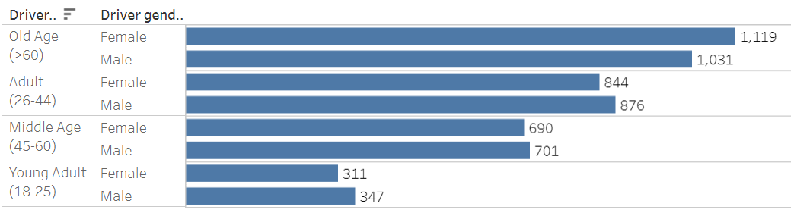
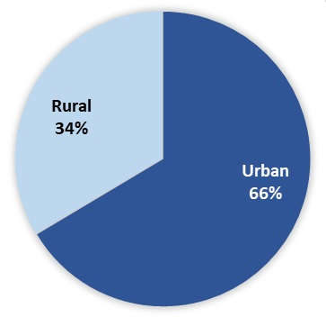
5 RESULTS & INTERPRETATIONS
Day of the week vs # vehicle crashes
Driver Age and Gender
Crash Location

Slide 9


5 RESULTS & INTERPRETATIONS
Confusion Matrix
Random Forest Classifier (Accuracy - 99.83%)
[427 0]
[ 0 772]
Gradient Boosting Classifier (Accuracy - 100%)
[427 0]
[ 2 770]

Slide 10
6 RECOMMENDATION & CONCLUSION
Random Forest Classifier is the most suitable model for our needs, with Gradient Boosting as a strong
secondary option.
Identified several critical factors influencing crash severity in India - engine type, weather conditions,
road surface conditions, time of day, day of the week and driver age.
Allows businesses and policymakers to optimize their resources by focusing efforts precisely where they
are needed, reducing moderate crashes through broad measures while ensuring severe crashes are accurately identified and addressed with intensive interventions
Supports strategic planning and decision-making processes, enabling more effective road safety campaigns, better risk assessments, and enhanced overall safety outcomes

Slide 11
7 REFERENCES
https://www.who.int/news-room/fact-sheets/detail/road-traffic-injuries#:~:text=Approximately%201.19%20million%20people%20die,adults%20aged%205%E2%80%9329%20years
Road Accidents in India 2022, Government of India, Ministry of Road Transport and Highways
https://www.kaggle.com/datasets/swish9/synthetic-indian-automobile-crash-data/data
Road Accidents in Kerala 2018-2022, Government of Kerala, Department of Economics and Statistics
https://www.firstpost.com/explainers/when-is-it-most-risky-to-be-on-the-indian-roads-11919432.html
https://www.argionislaw.com/car-accidents/who-causes-more-car-accidents-men-or-women/

Slide 12
THANK YOU

